Slide 1
WEB DESIGN UPDATE
August 13, 2010

Slide 2
Key Milestones
Today
7/19 | 7/26 | 8/2 | 8/9 | 8/16 | 8/23 | 8/30 | 9/6 | 9/13 | 9/20 | 9/27 | 10/4 | 10/11 | 10/18 | 10/25 | 10/29 | 11/8 | 11/15 | 11/22
Exec
Review
Design
Review
Resource
Review
LEC Demo
Exec
Review
Exec
Review
Launch
Expand
Social Logo
Home Page
Category Page
“Shop” Page
Configurator
Model details page
Social Logo demo
New Pages
Social Logo
Home Page
Masthead
“Products” Page
Category Pages (3)
Form Factor Pages (10)
Series Pages (30-40)
“Shop” Page
“Where to Buy” Page
Plus: Weekly & Daily interlocks:
Marketing / Web / Global Mktg. Community
Configurator
Model details page

Slide 3
Key objectives – October 25
Wow!
Tell the brand story. Products are the hero
Use 3rd party voices – what others say about us
Multi-channel call to action
Social content (selected by Lenovo for phase 1)
Easier for geo teams to localize

Slide 4
Today’s Review
Let’s look at some concepts…

Slide 5
Today’s Review
Social Logo ←
Home Page
Category
Shop
Configurator
Model Details
Project plan & Management System

Slide 6

social logo

Slide 7


Slide 8


Slide 9
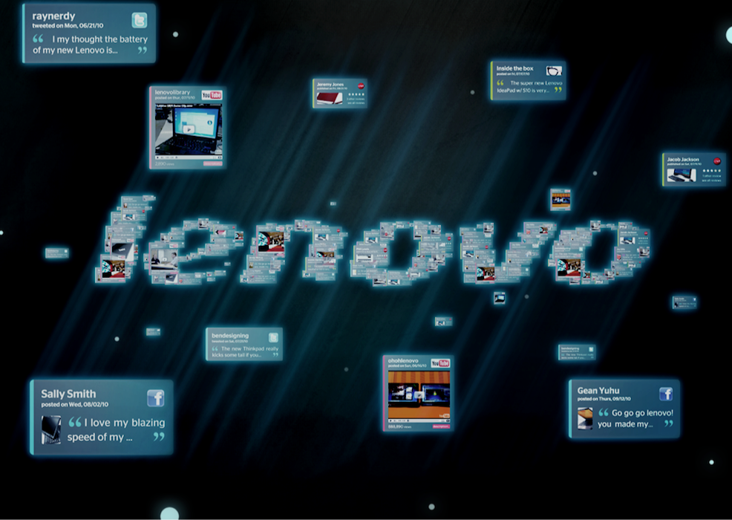

Slide 10
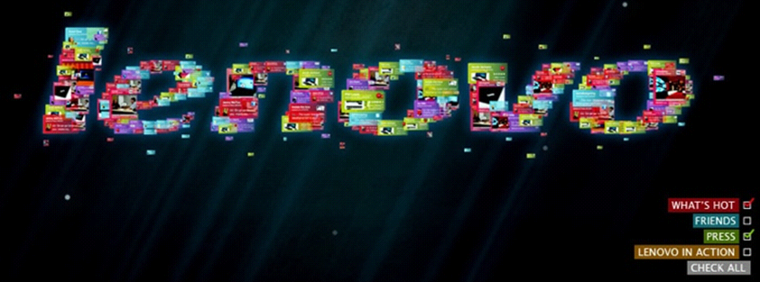
Social Logo (under construction)
-Facebook, e.g.
-Blog posts
-Local social accounts
-Brand stories
-Testimonials
-Hero images
-Press quotes
-Video tours
-Press quotes

Slide 11
Today’s Review
Social Logo
Home Page ←
Category
Shop
Configurator
Model Details
Project plan & Management System

Slide 12
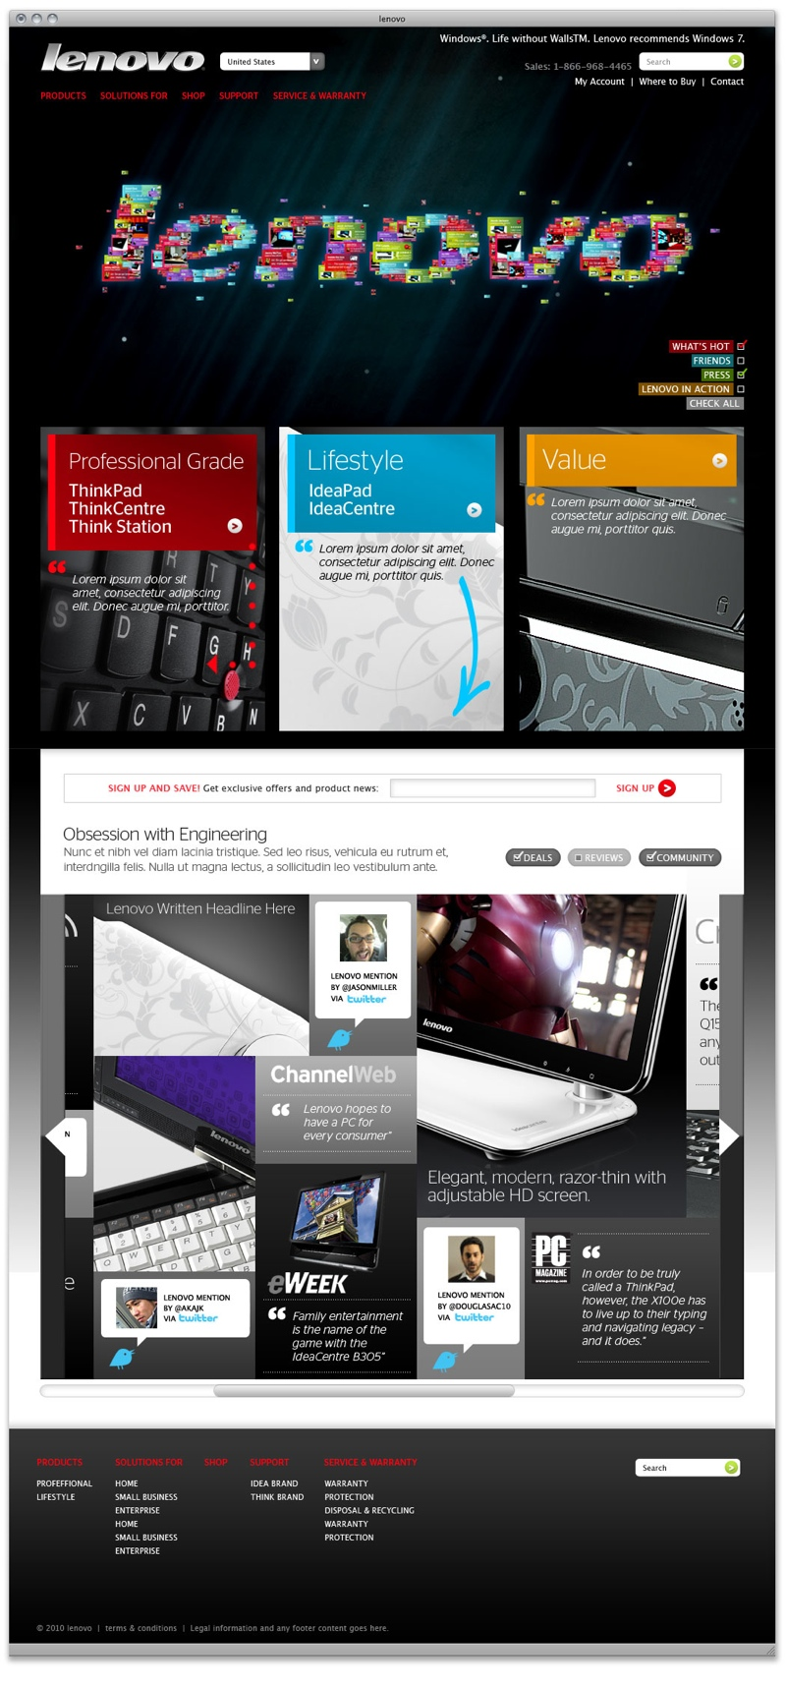

Slide 15
Today’s Review
Social Logo
Home Page
Category Page ←
Shop
Configurator
Model Details
Project plan & Management System

Slide 16
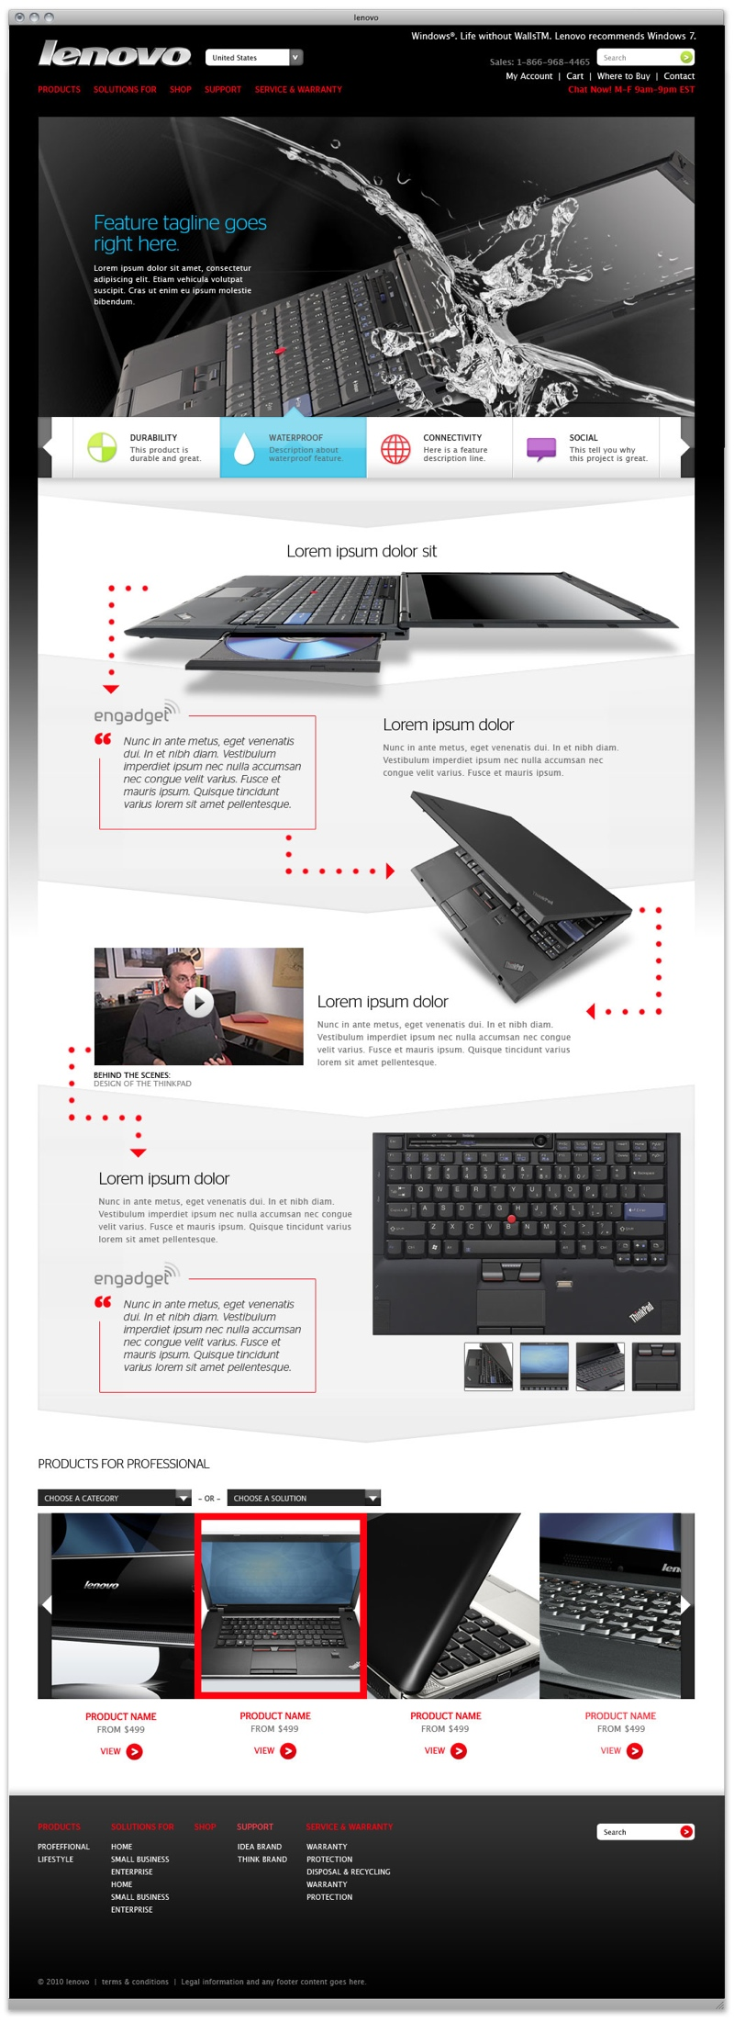

Slide 20
Today’s Review
Social Logo
Home Page
Category
Shop ←
Configurator
Model Details
Project plan & Management System

Slide 21
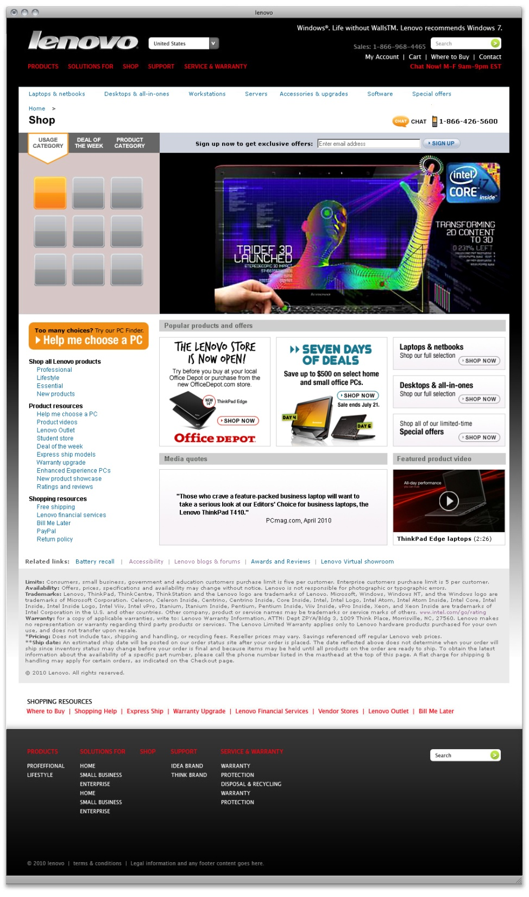
SHOP
Homepage

Slide 22
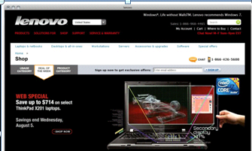
SHOP
Homepage

Slide 23
Today’s Review
Social Logo
Home Page
Category
Shop
Configurator ←
Model Details
Project plan & Management System

Slide 24
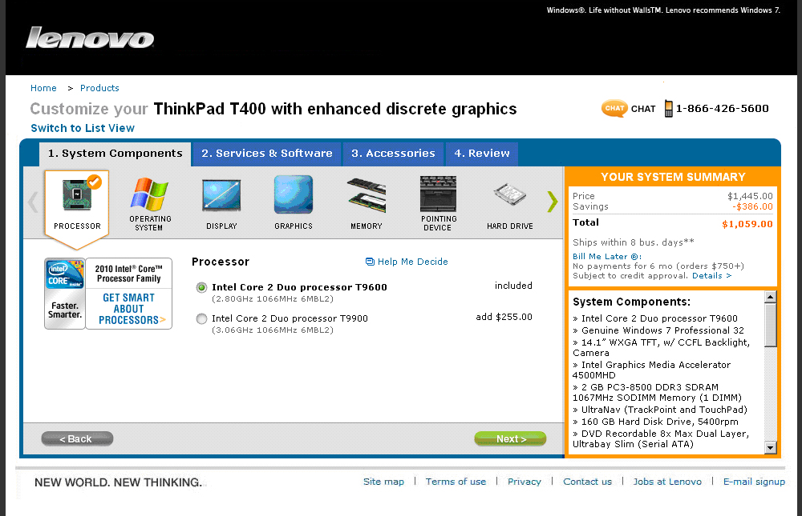
CONFIGURATOR

Slide 25
Today’s Review
Social Logo
Home Page
Category Page
Shop
Configurator
Model Details ←
Project plan & Management System

Slide 26
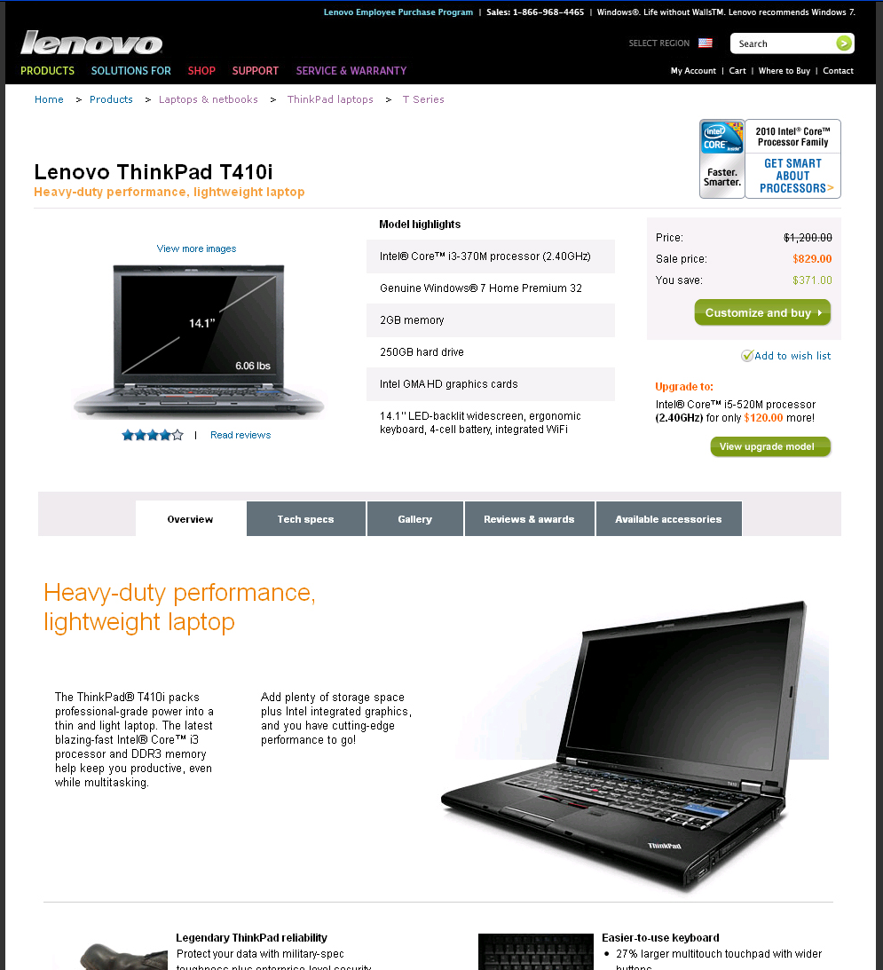
MODEL
DETAILS

Slide 27
Today’s Review
Social Logo
Home Page
Category Page
Shop
Configurator
Model Details
Project plan & Management System ←

Slide 28
eSupport - navigation change
10/25 – Masthead change only. Implemented by IBM on current systems.
March 2011 – eSupport will move to new infrastructure and new design

Slide 29
Key Milestones
Next
7/19 | 7/26 | 8/2 | 8/9 | 8/16 | 8/23 | 8/30 | 9/6 | 9/13 | 9/20 | 9/27 | 10/4 | 10/11 | 10/18 | 10/25 | 10/29 | 11/8 | 11/15 | 11/22
Exec
Review
Design
Review
Resource
Review
LEC Demo
Exec
Review
Exec
Review
Launch
Expand
Social Logo
Home Page
Category Page
“Shop” Page
Configurator
Model details page
Social Logo demo
New Pages
Social Logo
Home Page
Masthead
“Products” Page
Category Pages (3)
Form Factor Pages (10)
Series Pages (30-40)
“Shop” Page
“Where to Buy” Page
Plus: Weekly & Daily interlocks:
Marketing / Web / Global Mktg. Community
Configurator
Model details page

Slide 30
BACKUP

Slide 31
Fall release plan
10/4 | 10/11 | 10/18 | 10/25 | 11/1 | 11/8
JDA
Release
lenovo.com
relaunch
JDA
Release (R16)
Redesign enablers:
  CMS publishing upgrades
  Enable Masthead flexibility for 10/25
Other stakeholder-funded enhancements
Social Logo
Home Page
Masthead
“Products” Page
Category Pages (3)
Form Factor Pages (10)
Series Pages (30-40)
“Shop” Page
“Where to Buy” Page
Configurator redesign
Model details page
My Account / Product Registration integration
Other stakeholder-funded enhancements

Slide 32
REDESIGN PROJECT PLAN
Lenovo
Agency + Lenovo
JDA + Lenovo
Lenovo WW team
Lenovo Geo team
6/14 | 6/21 | 6/28 | 7/5 | 7/12 | 7/19 | 7/26 | 8/2 | 8/9 | 8/16 | 8/23 | 8/30 | 9/6 | 9/13 | 9/20 | 9/27 | 10/4 | 10/11 | 10/18 | 10/25 | 10/29 | 11/8 | 11/15 | 11/22
Exec
Review
Design
Review
Resource
Review
LEC Demo
Exec
Review
MCP 2 ready (9/1)
MCP 2 launch 10/1
New Home Page &
Learn Flow:
Incl. Home Page, Category,
Form Factor, Series,
+ Shop home page & Where to Buy
(Sub Series added post 10/25)
Wire
frames
Visuals
HTML
Teamsite
Presentation Layer
“Capture Templates”
Wave 1
Train
Train
Geo Q/A
WW
Prepare assets
Enter content
Geo Localize Wave 1
Wave 2
Prepare assets
Enter content
Localize Wave 2
Wave 3
Prepare assets
Enter content
Localize Wave 3
Q/A
(10/30 U260 launch)
Build out sub-series
Social Logo
WW
Concept
Design & Prototyping
Development
Q/A
Shop & My Account
incl. CMS enablement, Masthead,
Configurator & Model Details
DR Release live (10/4)
(with redesign enablers)
R16 live (11/8)
(with
configurator,
model details)
Digital River
Concept & Blueprint Phases
Implementation
R16
Implementation
FAST Search
Blueprint
Metadata / sitemaps
(Awaiting new pages and functions)
Development /
Processing
Q/A
eSupport (Nav update)
Design
Nav
Requirements/
RFS to IBM
Development
Testing

