Slide 1
Watch Station International
3/25/2011

Slide 3
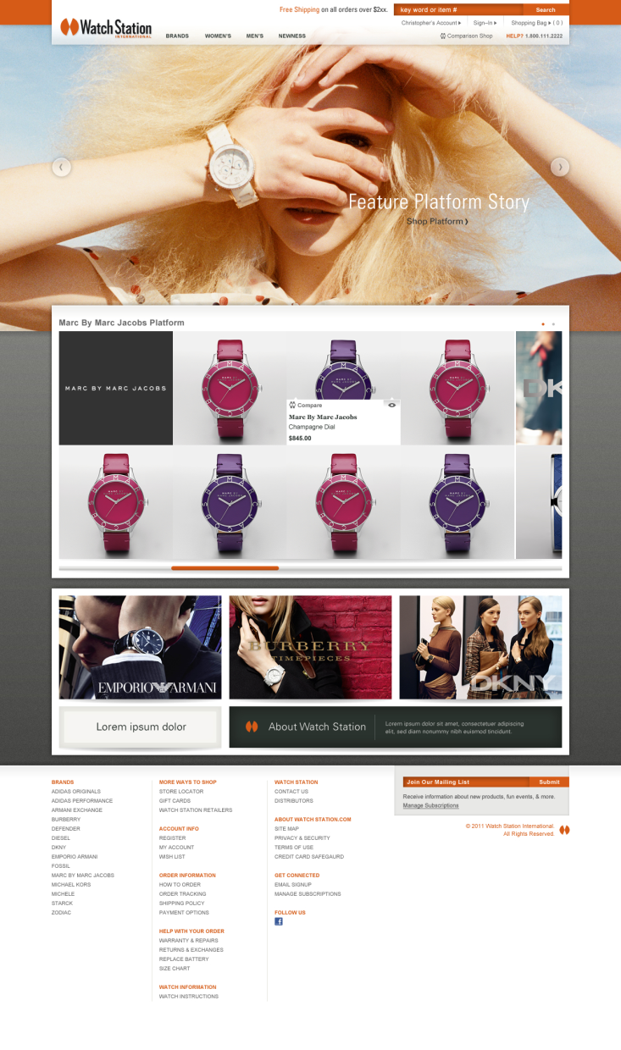
HOME PAGE
[A] Global Navigation Bar
-transparent to allow image to show through
[B] Featured Platform Region
-full image
-rotates through multiple platforms
-next and previous button
[C] Platform Story
-displays multiple platform stories
-Products are associated with the Featured Platform Region
-drop down menu sorts men’s and women’s
-horizontal scroll bar
[D] Espots
-espots will showcase secondary branded content, and platform stories
-includes espot for “about us”
[E] Footer
-information clearly defined
-includes brands list
-includes email sign-up
[A]
[B]
IE7 browser
[C]
[D]
[E]

Slide 4
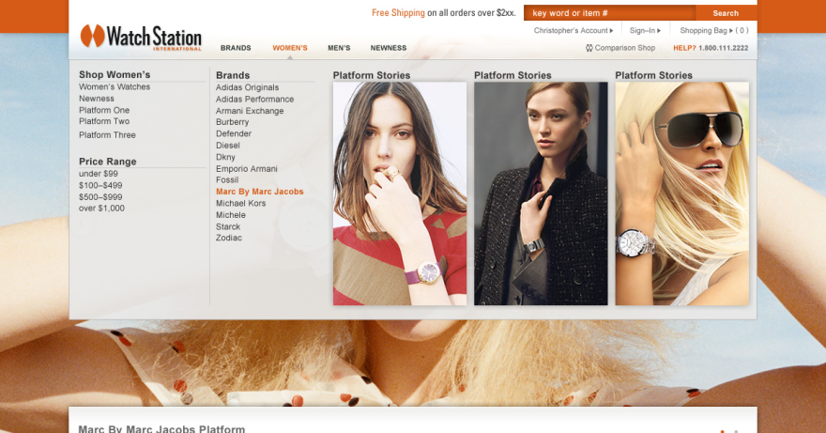
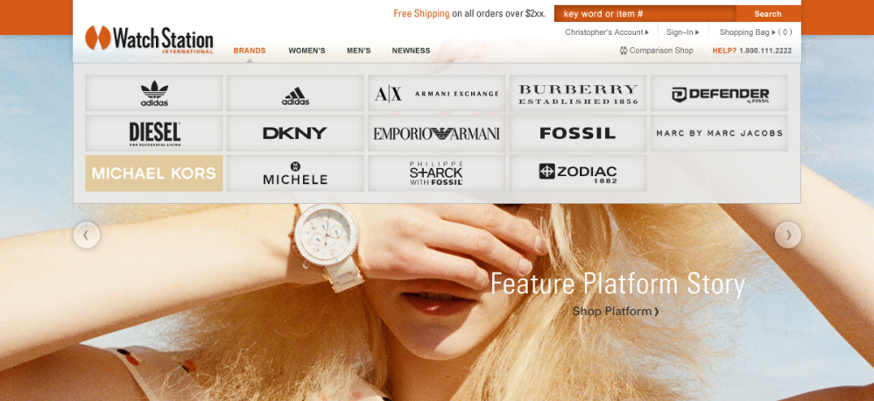
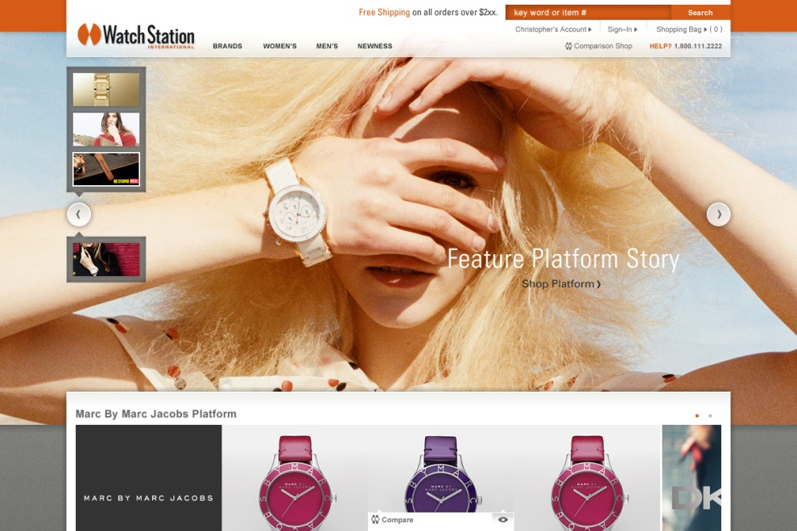

Slide 5
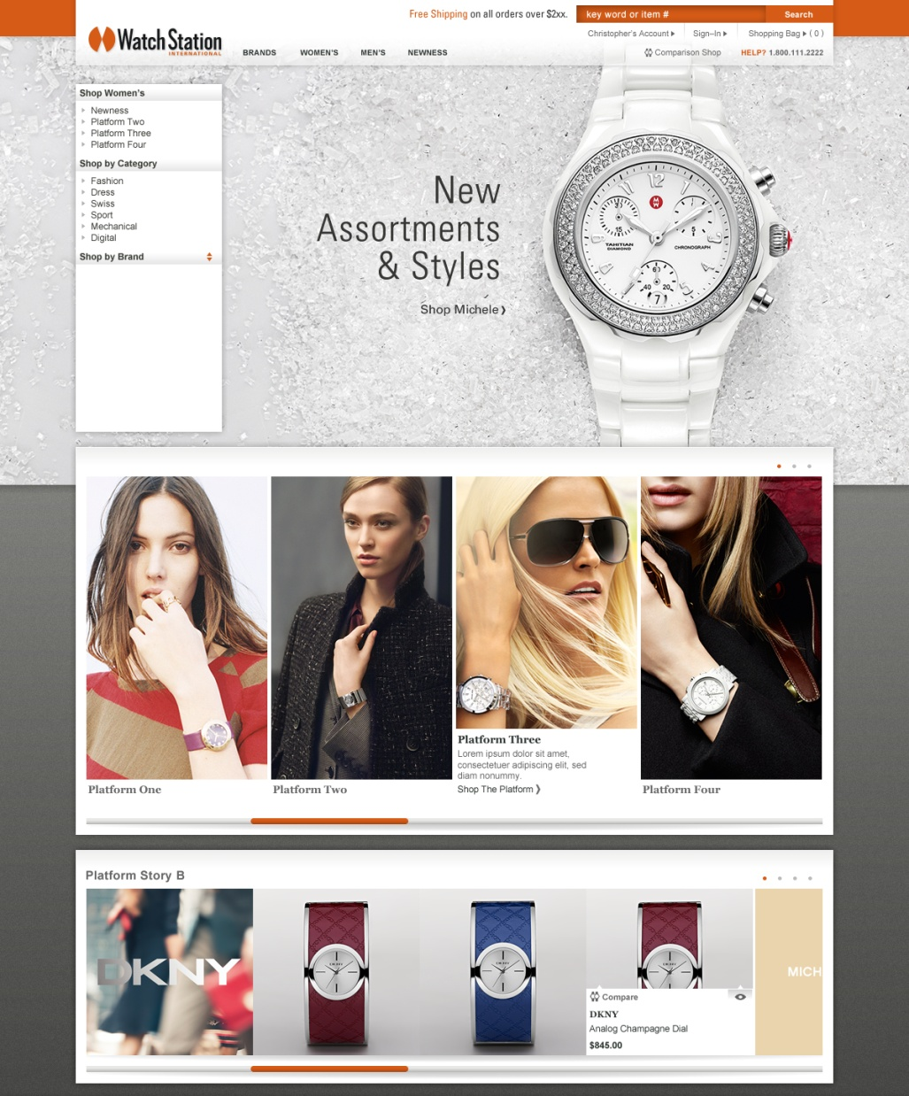
GENDER BOUTIQUE
[A] Side Navigation
-highlights key-sort items specific to gender
[B] Main Featured Platform Region
-Full image
can rotates through multiple features as needed. For launch, this will be static.
[C] Featured Platforms
-visual representation of featured collections
-correlates with side navigation
-horizontal scroll bar
[D] Platform Story B
-displays multiple platform stories
-drop down menu sorts men’s and women’s
-horizontal scroll bar
[A]
[B]
[C]
[D]

Slide 6
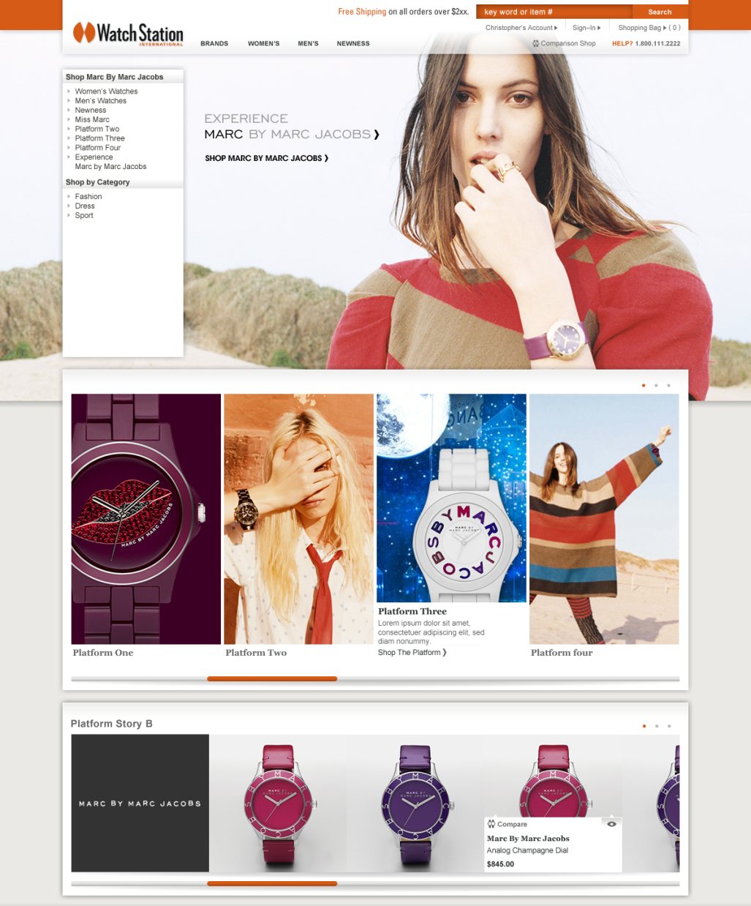
BRAND BOUTIQUE
[A] Side Navigation
-highlights key-sort items specific to the brand
[B] Main Featured Platform Region
-Full image
can rotates through multiple features as needed.
(For launch, this will be static.)
[C] Featured Platforms
-visual representation of featured collections
-correlates with side navigation
-horizontal scroll bar
[D] Custom Branding
-background color can be brand specific
[E] Platform Story B
-displays multiple platform stories
-drop down menu sorts men’s and women’s
-horizontal scroll bar
[B]
[A]
[C]
[D]
[E]

Slide 7
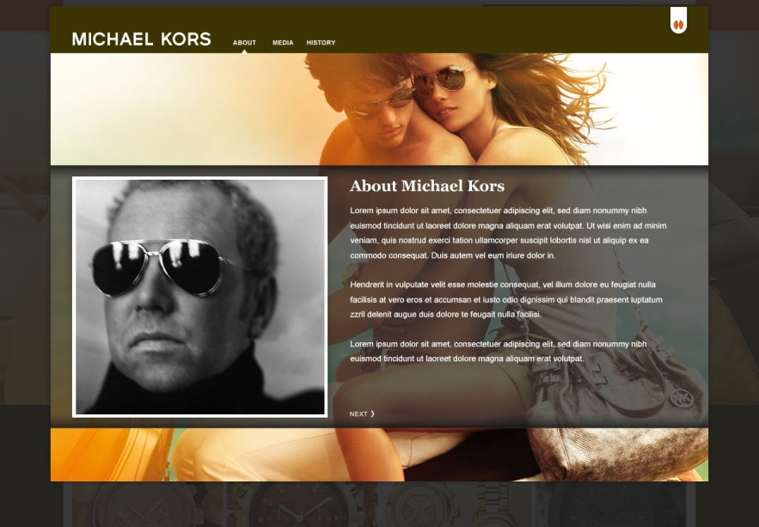
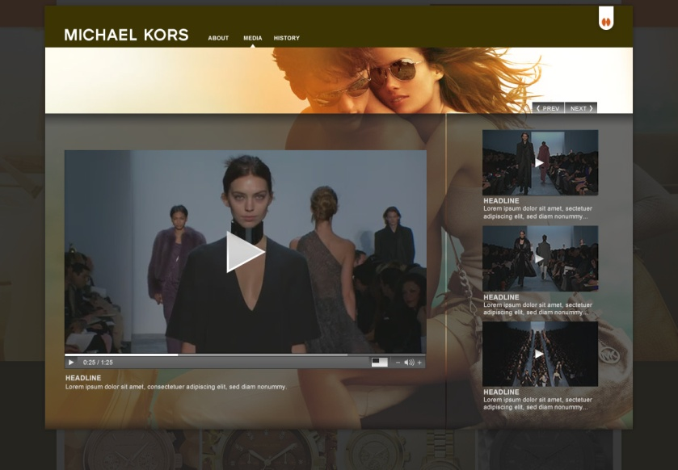
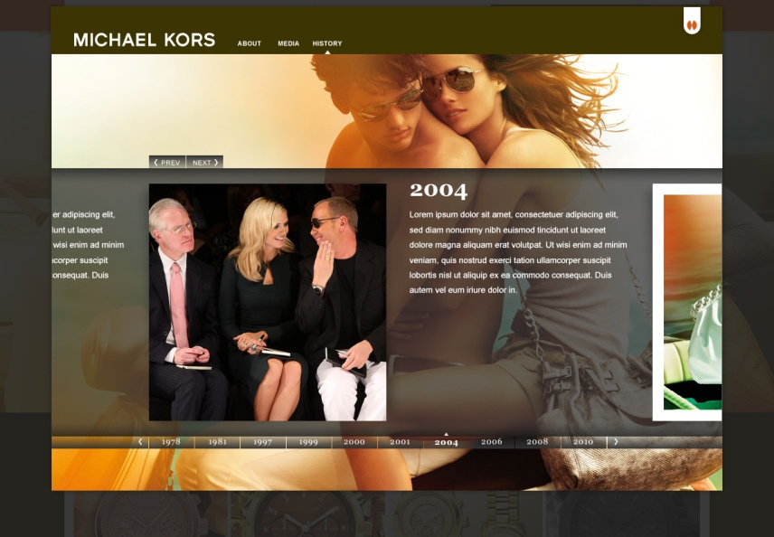
BRAND EXPERIENCE
MINI SITE MODAL
Each brand will have the opportunity to
showcase specific media, news, or other information related to said brand.
This includes connecting certain points between the shopping experience and the brand experience.

Slide 8
BRAND LIST RESULTS PAGE
[A] Bread Crumb Filters
[B] Comparison Shop
-The ability to put multiple products side by side and compare them to each other
[C] Quick Look
-clicking in the list sort row, or the icon on the individual product opens a modal view
[D] Filter Controls
-product views { front, side, and back
-sort by { recommended, price, newness, best seller, highest rated
-previous and next depending on results
[E] Side Navigation
-detailed options built from multiple parameters
-live sorting
[F] Custom Branding
-the banner and background color
are brand specific
[A]
[D]
[F]
[E]
[B]
[C]

Slide 9
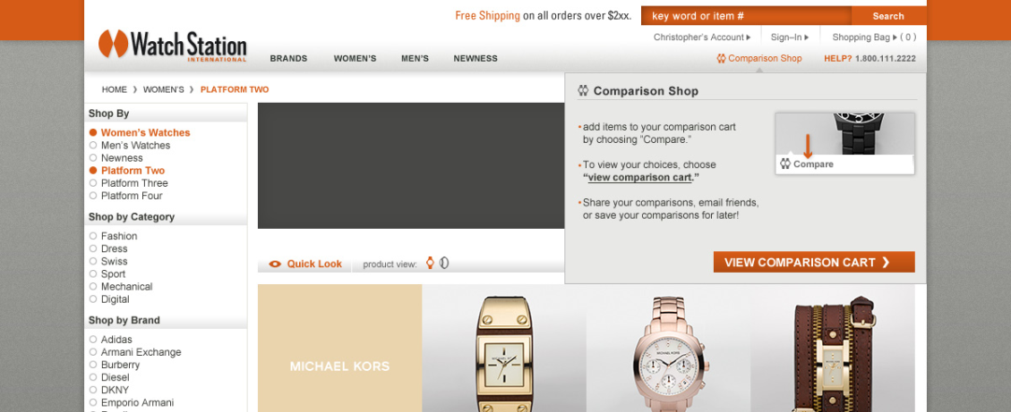
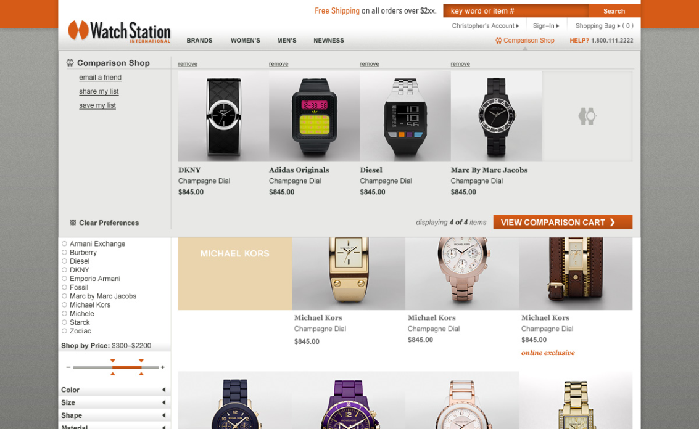
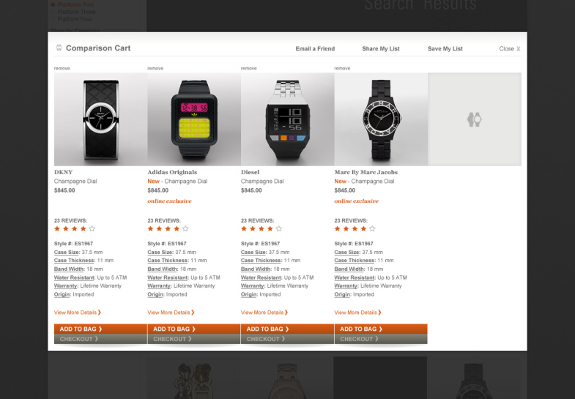
COMPARISON SHOP
Comparison drop menu functions similar to
the shopping bag.
[A] Empty Comparison cart
[B] Select a watch to compare. It will show up in the drop menu as well as your comparison cart.
[C] To view the comparison cart, click “view comparison cart.” You can remove items by clicking remove, or add the item to your cart
or checkout.

Slide 10
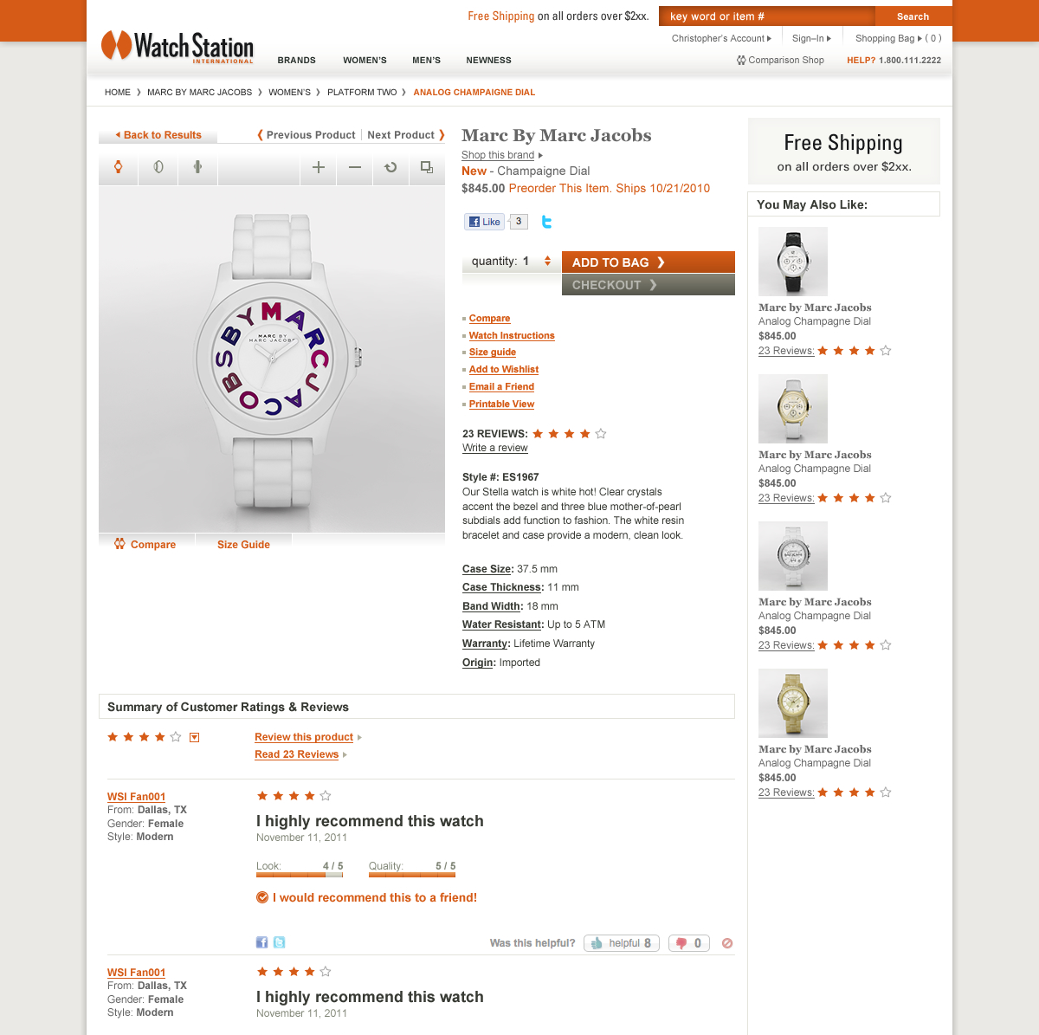
PRODUCT DETAIL PAGE
[A] Bread Crumb Filters
[B] Back to Results Button
[C] Previous and Next Product in list results
[D] Multiple Views
-front, side, and back
-zoom function
-view larger
[E] Product Details
-when you rollover Case Size, Thickness, Band Width, Water Resistance, Warranty, and Origin, a tool tip will appear to give you specific information on that item to let you know what the relevance of this callout is.
[F] Cross Sell Function
[G] Customer Reviews
-”over all” rating
-”look” rating
-”quality” rating
-cleaner look
[A]
[B]
[C]
[D]
[F]
[E]
[G]

Slide 11
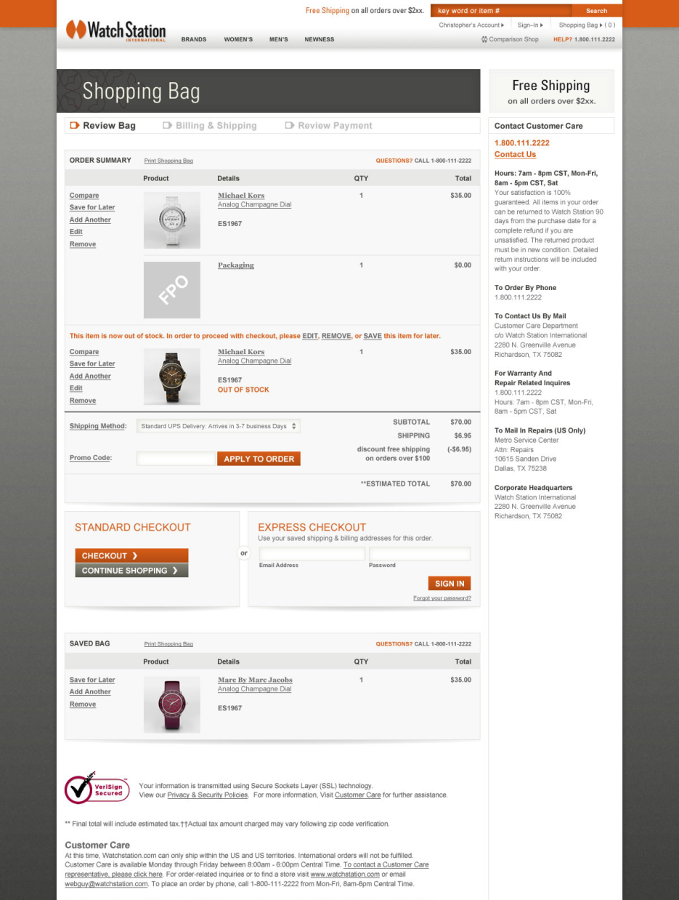
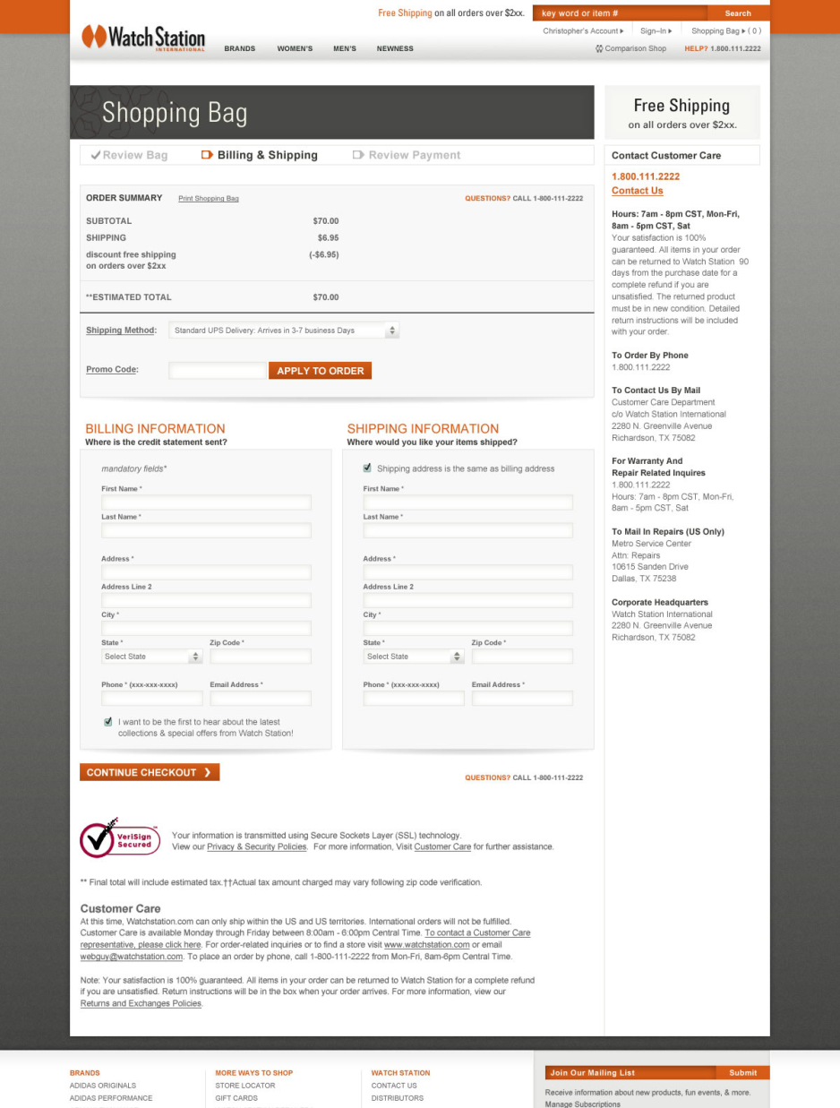

Slide 12
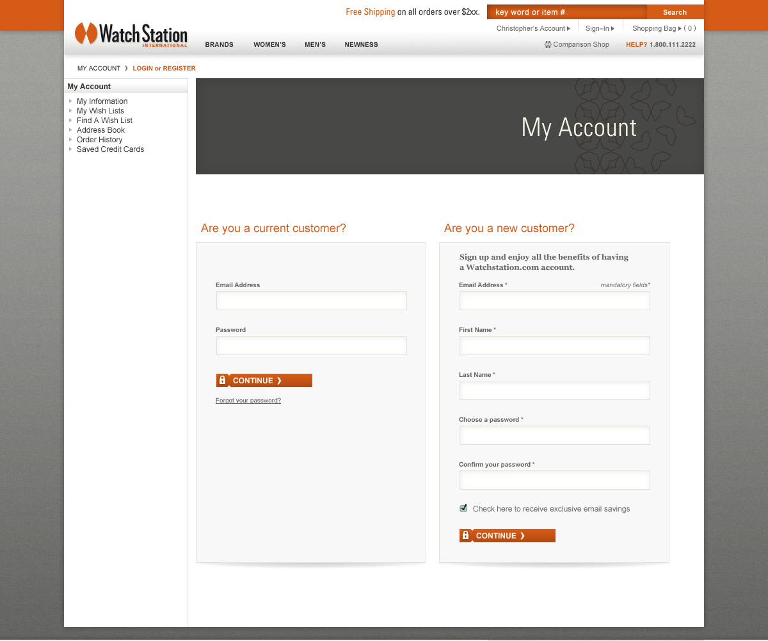
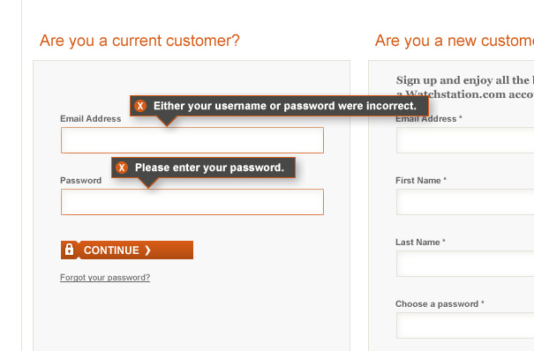
MY ACCOUNT
login

